Slide 1
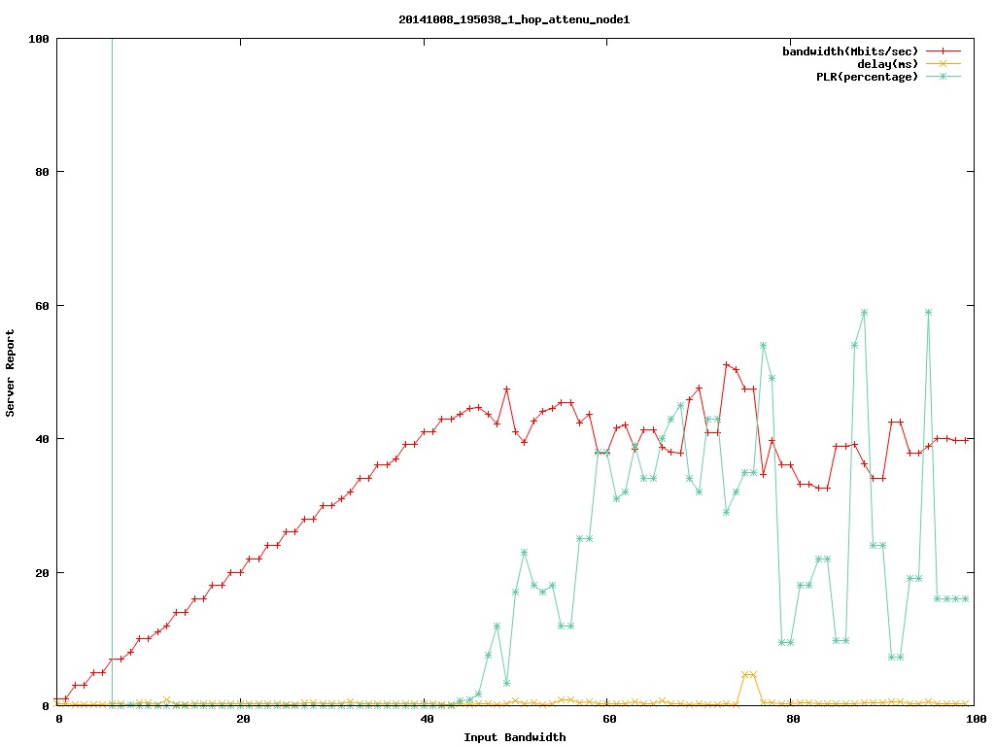
单跳衰减
1
2
3
4
5

Slide 2
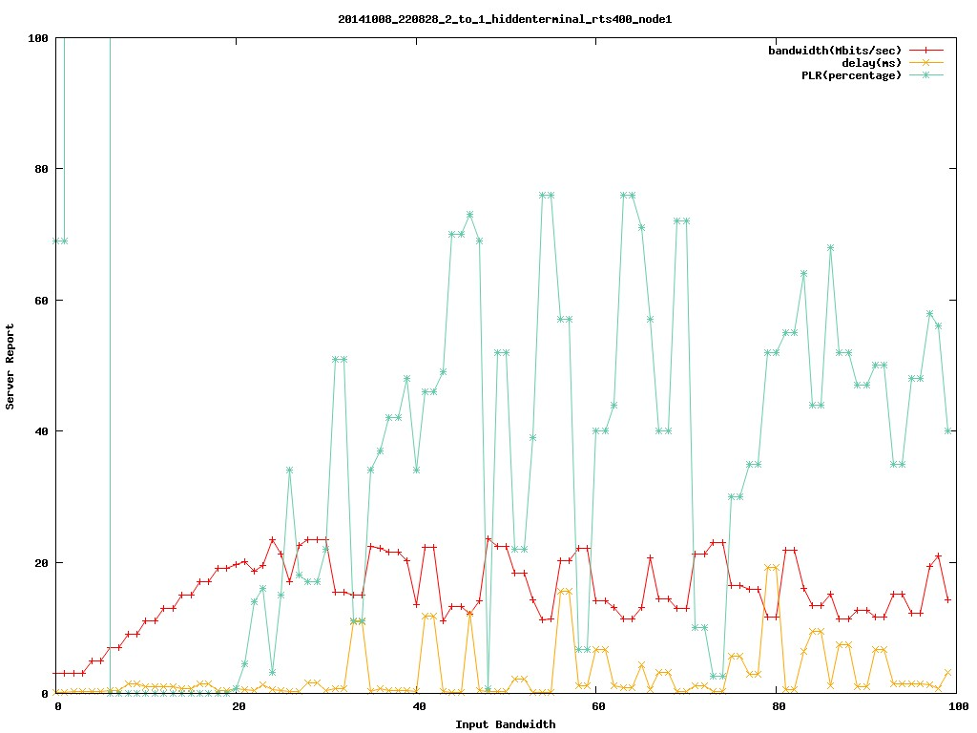
隐终端 rts thr=400 节点1
1
2
3
4
5

Slide 3
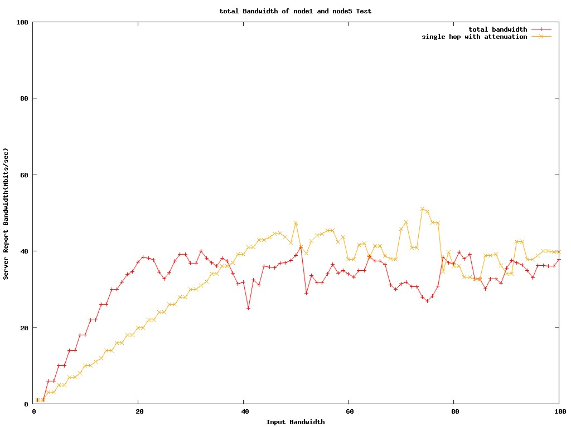
单跳衰减Vs隐终端并发

Slide 4
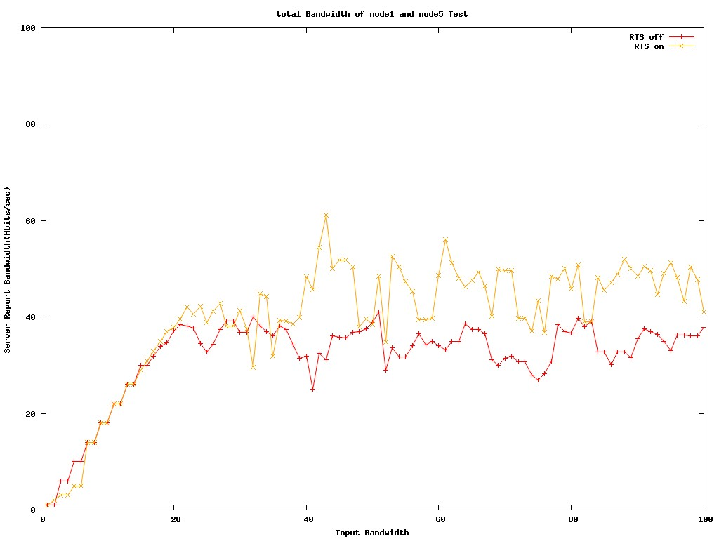
隐终端并发 RTS ON vs OFF

Slide 5
隐终端并发
1
2
3
4
5

Slide 6
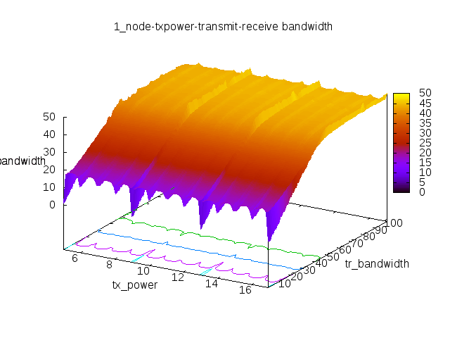
RTS ON , Mesh node 1

Slide 7
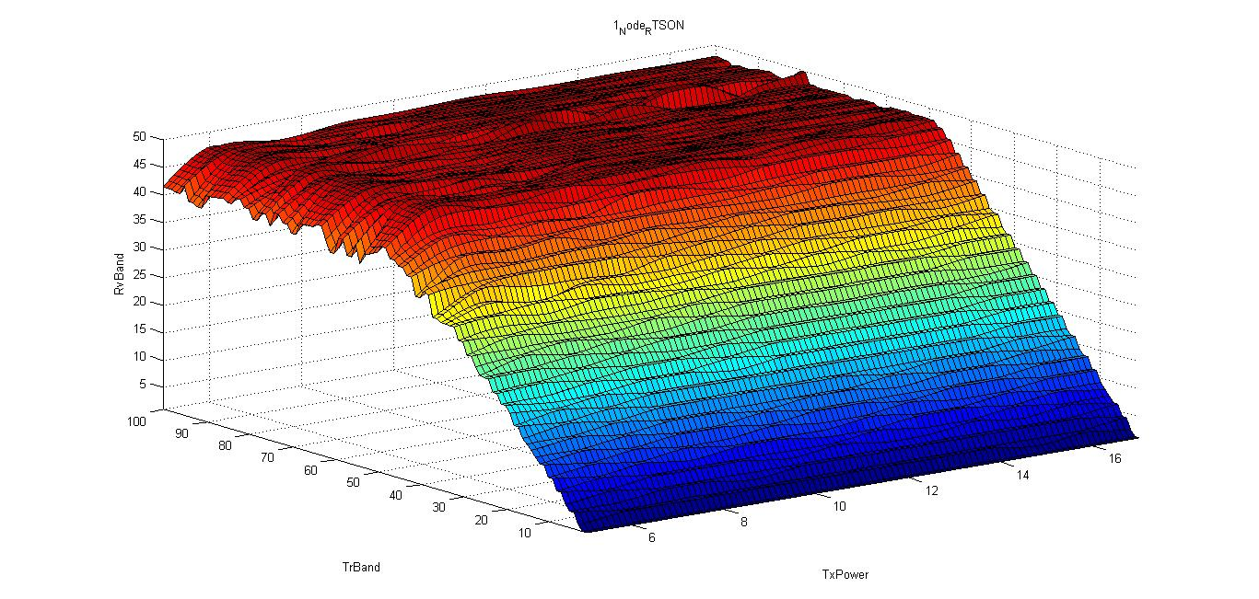
RTS ON , Mesh node 1-Matlab

Slide 8
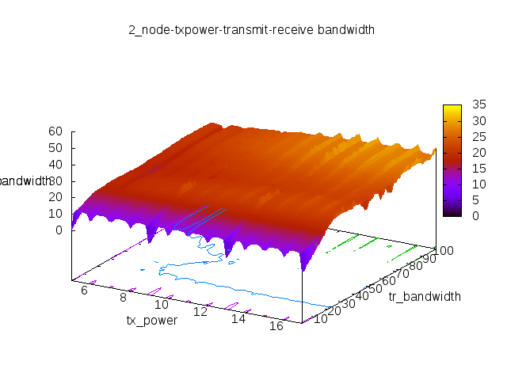
RTS ON , Mesh node 5

Slide 9
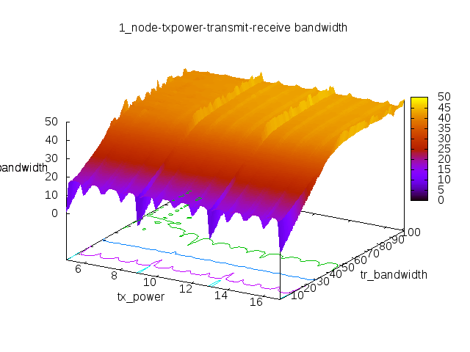
RTS OFF , Mesh node 1

Slide 10
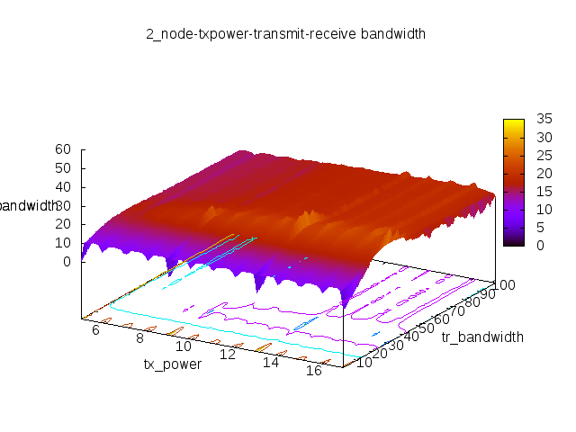
RTS OFF , Mesh node 5

Slide 11
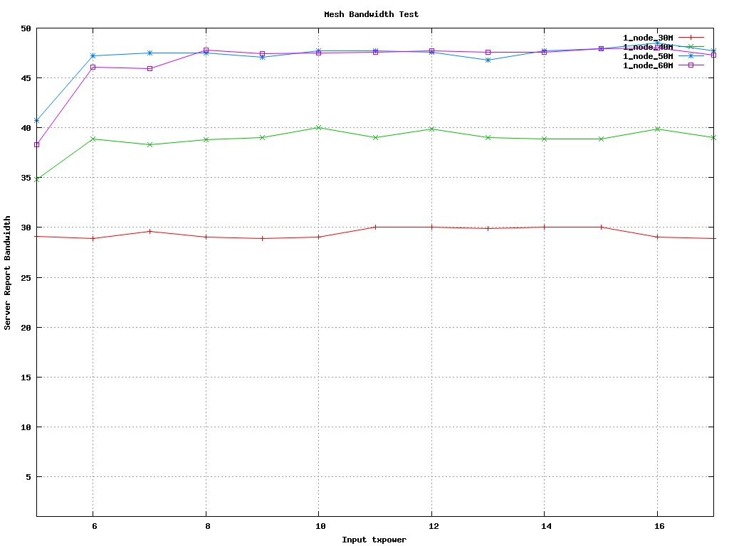
RTS ON , Mesh node1,tr_bandwidth=30,40,50,60

Slide 12
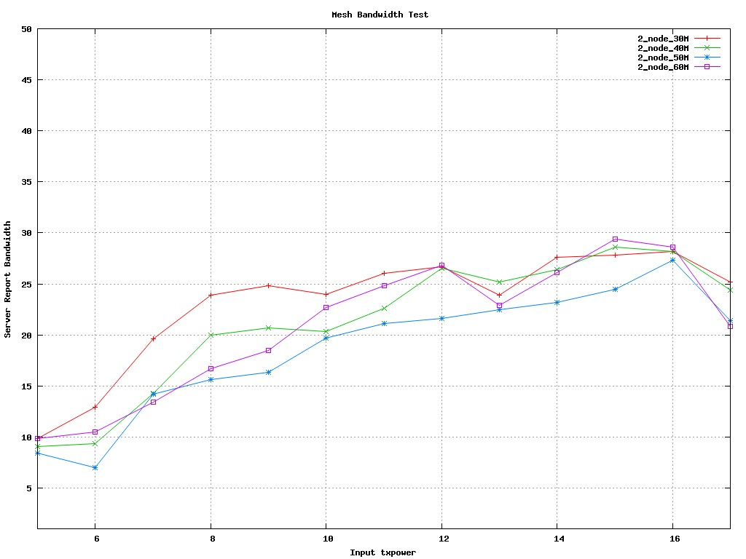
RTS ON , Mesh node5,tr_bandwidth=30,40,50,60

Slide 13
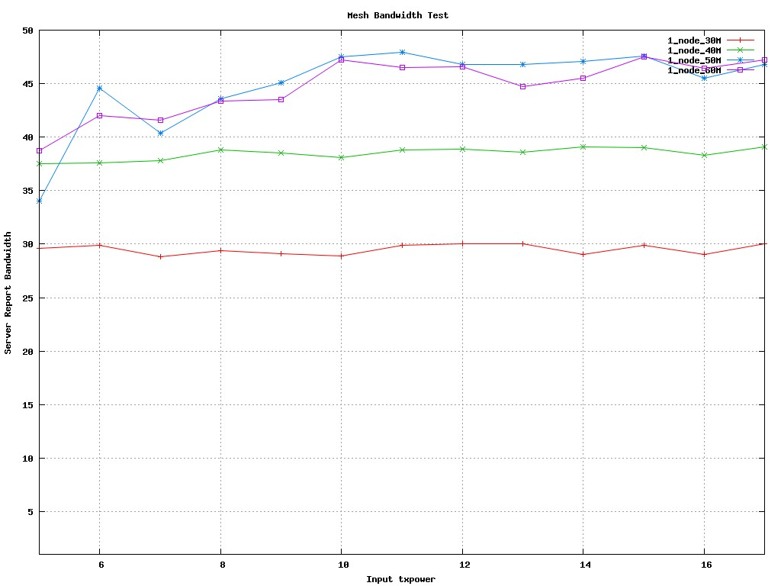
RTS OFF , Mesh node1,tr_bandwidth=30,40,50,60

Slide 14
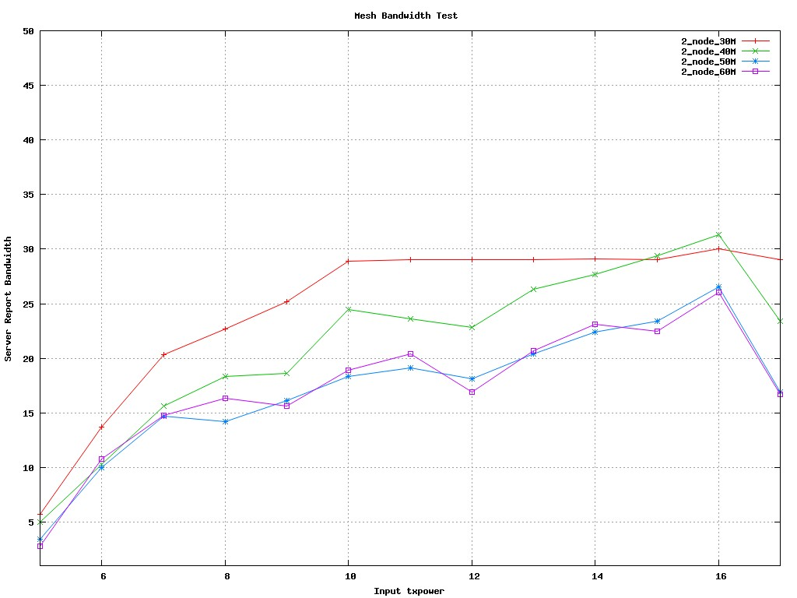
RTS OFF , Mesh node5,tr_bandwidth=30,40,50,60

Slide 15
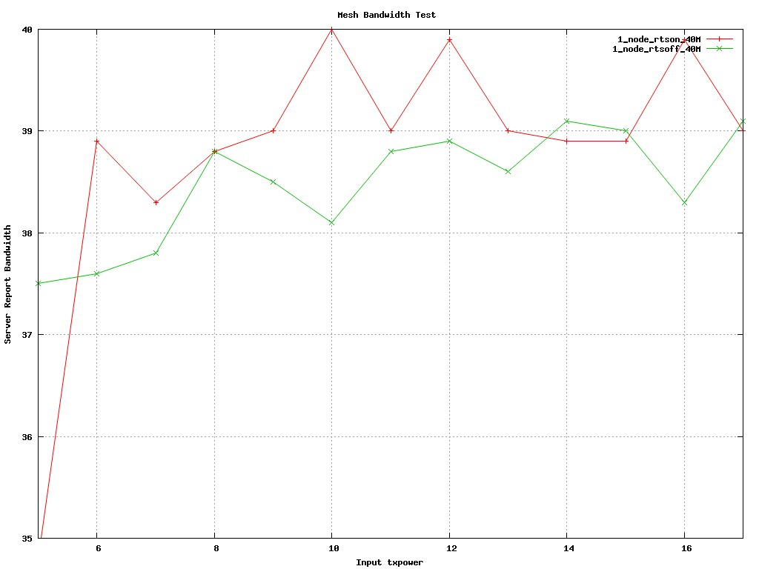
tr_bandwidth=40Mbps， RTS ON vs OFF

Slide 16
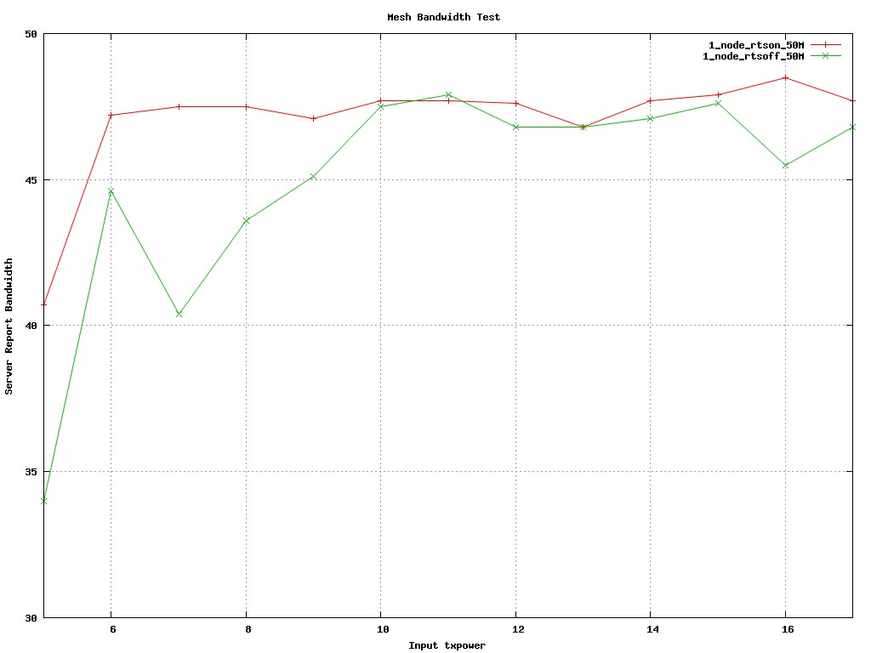
tr_bandwidth=50Mbps， RTS ON vs OFF

Slide 17
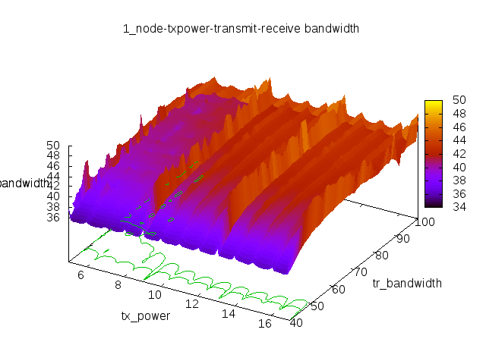
RTS ON vs OFF , Mesh node 1-Part

